Slide 1
Aerobic Nonspore-Forming Gram-Positive Bacilli
Listeria
Corynebacterium
Propionibacterium
Erysipelothrix
Actinomycetes

Slide 2
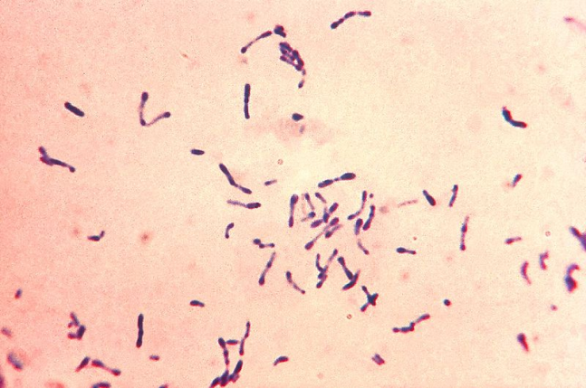
Genus: Corynebacterium
Species: Corynebacterium diphtheriae
Corynebacteria are 0.5–1 m in diameter and several
micrometers long. Characteristically, they possess irregular
swellings at one end that give them the "club-shaped“
appearance
Irregularly distributed within the rod (often near the poles) are
granules staining deeply with aniline dyes (metachromatic
granules) that give the rod a beaded appearance. Individual
corynebacteria in stained smears tend to lie parallel or at acute
angles to one another.

Slide 3
Diphtheria bacilli are pleomorphic, non-capsulate, non-sporing
Gram-positive rods
Their morphology varies, even within one strain, depending on
the age of the culture
Typing of diphtheria bacilli:
Serotyping
Bacteriophage typing
Bacteriocin typing
Possess three distinct antigens;
A deep-seated antigen
A heat-labile protein (K antigen)
A heat –stable polysaccharide (O antigen)

Slide 4
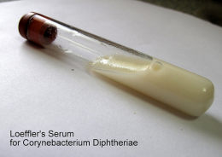
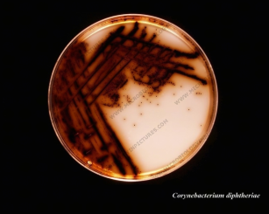
Culture & Growth
C diphtheriae and other corynebacteria grow aerobically on most
ordinary laboratory media:
* On Loeffler serum medium,
Corynebacteria grow much more readily than other respiratory
organisms
* On blood agar,
the C diphtheriae colonies are small, granular,
and gray, with irregular edges, and may have small zones of
hemolysis.
* On agar containing potassium tellurite,
the colonies are brown to black with a brown-black halo because the tellurite is reduced intracellularly (staphylococci and streptococci can also produce black colonies).

Slide 5
Three biotypes of C diphtheriae have been widely recognized: gravis: large colonies, grey-black, small zone of haemolysis
mitis: smaller convex, grey-black soft colonies, small zone of Hae
intermedius: the smallest grey-black colonies
These variants have been classified on the basis of growth
characteristics such as:
* colony morphology
* biochemical reactions,
* and severity of disease produced by infection.

Slide 6
Pathogenesis
C diphtheriae occurs in the respiratory tract, in wounds, or on the
skin of infected persons or normal carriers.
It is spread by droplets or by contact to susceptible individuals; the
bacilli then grow on mucous membranes or in skin abrasions, and
those that are toxigenic start producing toxin.
* Invasion * Toxigenesis
C. diphtheriae toxin : is a heat-labile polypeptide that can be lethal
in a dose of 0.1 g/kg.
It’s in vitro production depends on:
*Concentration of Iron
*Osmotic pressure
*Amino acid concentration
*pH
*Availability of suitable carbon and nitrogen sources

Slide 7
Pathogenesis
In respiratory tract:
Diphtheria toxin cause a grayish “pseudomembrane” over the
tonsils, pharynx, or larynx.
In wound or skin:
Diphtheria occur in the tropics and the virulence of diphtheria
bacilli is due to:
*Capacity of establish infection
*growing rapidly
*Then quickly elaborating toxin that is effectively absorbed

Slide 8
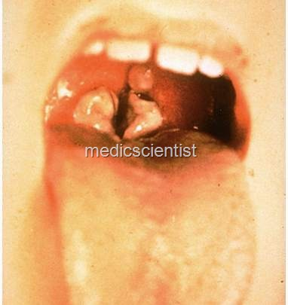
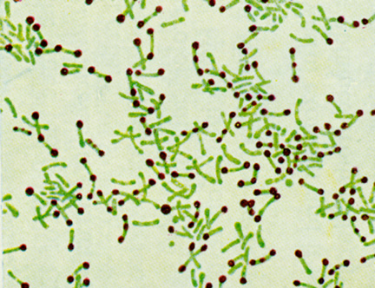
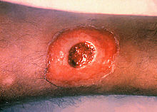
Albert’s stain
Pseudomembrane over the tonsils
A diphtheria skin lesion on the leg

Slide 9
Diagnosis and lab tests
Swabs from the nose, throat, or other suspected lesions must be
obtained before antimicrobial drugs are administered.
Smears stained with alkaline methylene blue or Gram stain
show beaded rods in typical arrangement.
Specimens should be inoculated to a blood agar plate (to rule
out hemolytic streptococci), a Loeffler slant, and a tellurite
plate (eg, cystine-tellurite agar or modified Tinsdale's medium)
Incubate at 37°C. In 12–18 hours, the Loeffler slant may yield
organisms of typical "diphtheria-like" morphology. In 36–48
hours, the colonies on tellurite medium are sufficiently definite
for recognition of C diphtheriae.

Slide 10
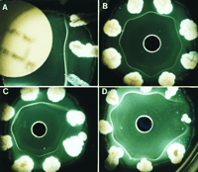
Diagnosis and lab tests. Cont
C diphtheriae isolate should be subjected to testing for toxigenicity.
there are several methods, as follows:
Method 1:
A filter paper disk containing antitoxin (10 IU/disk) is placed on an agar plate. The cultures to be tested for toxigenicity are spot innoculated 7–9 mm away from the disk. After 48 hours of incubation, the antitoxin diffusing from the paper disk has precipitated the toxin diffusing from toxigenic cultures and has resulted in precipitin bands between the disk and the bacterial growth. This is the modified Elek method described by the WHO Diphtheria Reference Unit.

Slide 11
Diagnosis and lab tests. Cont
Method 2:
Polymerase chain reaction-based methods have been described for detection of the diphtheria toxin gene (tox). PCR assays for tox can also be used directly on patient specimens before culture results are available. A positive culture confirms a positive PCR assay. A negative culture following antibiotic therapy along with a positive PCR assay suggests that the patient probably has diphtheria.

Slide 12
Diagnosis and lab tests. Cont
Enzyme-linked immunosorbent assays can be used to detect diphtheria toxin from clinical C diphtheriae isolates.
An immunochromographic strip assay allows detection of diphtheria toxin in a matter of hours. This assay is highly sensitive.
injecting two guinea pigs with the emulsified isolate

Slide 13
Treatment
AntiMicrobial drugs (penicillin, erythromycin) inhibit the growth
of diphtheria bacilli
Early administration of specific antitoxin against the toxin formed
by the organisms at their site of entry and multiplication.

Slide 14
Preventation & Immunization
Active immunization in childhood with diphtheria toxoid
yields antitoxin levels that are generally adequate until
adulthood.
Young adults should be given boosters of toxoid
The principal aims of prevention are to limit the distribution of
toxigenic diphtheria bacilli in the population and to maintain
as high a level of active immunization as possible.

Slide 15
Toxoid preparation
A filtrate of broth culture of a toxigenic strain is treated with 0.3% formalin and incubated at 37°C until toxicity has disappeared. This fluid toxoid is purified and standardized in flocculating units (Lf doses). Fluid toxoids prepared as above are adsorbed onto aluminum hydroxide or aluminum phosphate. This material remains longer in a depot after injection and is a better antigen. Such toxoids are commonly combined with tetanus toxoid (Td) and sometimes with pertussis vaccine (DPT or DaPT) as a single injection to be used in initial immunization of children

